Slide 1


Connecting Hunters and Landowners: Evaluation of Ohio’s Cooperative Program
Terrestrial Wildlife Ecology Laboratory, School of Environment & Natural resources, The Ohio state university
Melissa Stanger, Jeremy Bruskotter, Gabriel Karns, Kristina Slagle, Alia Dietsch.
Notes:
-Hi, I’m here to talk about an evaluation of Ohio’s Cooperative Hunting, Trapping, and Fishing program which connects sportsmen and women with landowners who are willing to grant access on their private lands.
-This research was conducted by the Ohio State University
-I am Melissa Stanger and I would also like to acknowledge Jeremy Bruskotter, Gabe Karns, Kristina Slagle, and Alia Dietsch

Slide 2

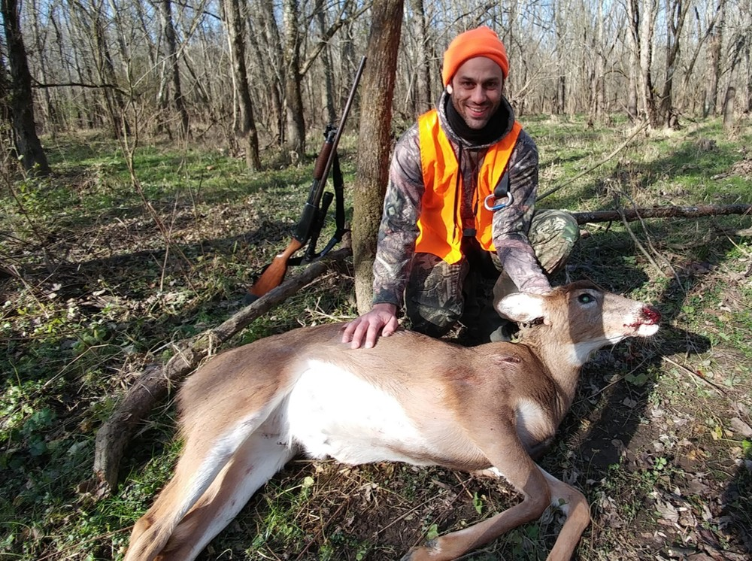
Background of Wildlife Conservation and Hunting in the United States
Wildlife are a public trust
State government is the trustee
The public are the beneficiaries
Accessible hunting is central to the North American Model of Wildlife Conservation.
State agencies get a large portion of their funding through sales of hunting, fishing, and trapping licenses and permits.
Notes:
-I want to start by giving a brief background of wildlife conservation and hunting in the United States. As part of the North American Model of Wildlife Conservation, wildlife are considered a public trust, where the state government is the trustee and the public are the beneficiaries.
-This means that each of the 50 state governments manage their own wildlife and hold authority in decision-making… but wildlife are also considered to be a public resource, meaning these state governments must manage with the public interest in mind.
-Accessible hunting is central to the North American Model of Wildlife Conservation, and is used a management tool (for example, to reduce overabundant species such as deer).
-State agencies also receive a large portion of their funding through the sale of hunting, fishing, and trapping licenses and permits.

Slide 3
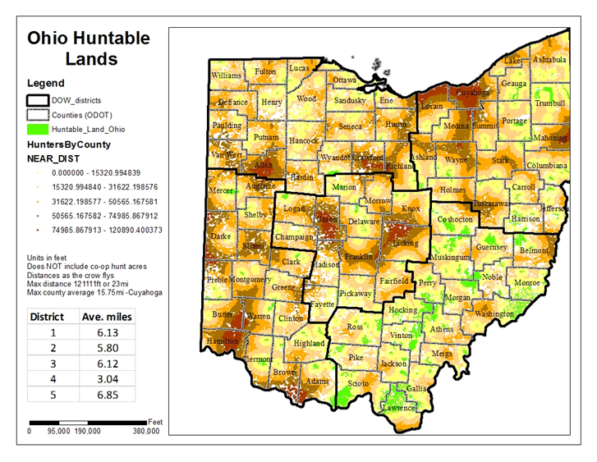
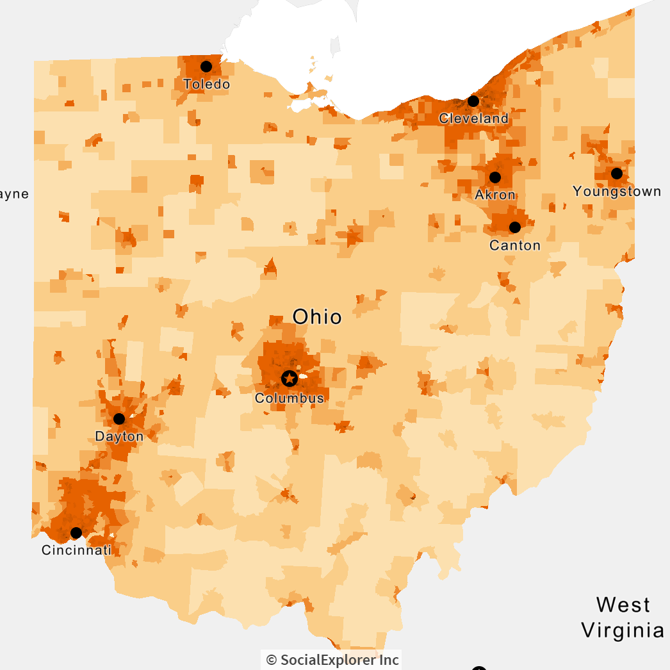
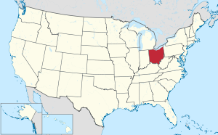
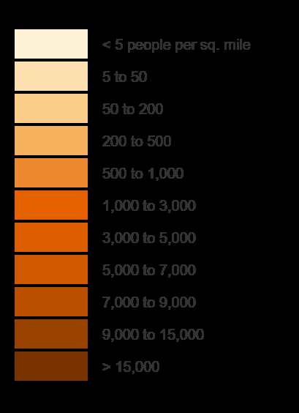
Less Than 3% of Ohio’s Huntable Lands are Public
Notes:
-To quickly orient us all, here’s a map in the top-right corner depicting the United States with Ohio displayed in red.
- In the image on the left, we see a larger version of Ohio.
-Ohio has 5 major metropolitan areas. This map from 2010 census data, shows the population densities in Ohio. The darker the pigment, the greater the population density.
-Many of these dark areas coincide with areas of Ohio that are far from huntable public land.
*SWITCH SLIDES*
- Less than 3% of Ohio’s lands are publicly available to hunters, which can create issues of crowding, and crowding can be dangerous when hunting.
-In this map of Ohio, the green represents publicly available huntable lands. The other colors represent the degree of driving time to reach these public lands.
-The light yellow represents those who live closer to public lands, and the driving distance increases as we move to light orange, dark orange, brown, and finally red, which represents locations with the farthest driving distance to huntable public lands.
-Ohio is one of the 50 states that manages wildlife under the North American model, yet we lack public land on which people can hunt. Thus, we have to figure out how to allow these opportunities to meet management goals or human-wildlife conflict can arise. For example, deer eating crops. We need to connect landowners who are willing to allow recreation activities on their properties to sportsmen and women wanting to engage in these activities.

Slide 4
Less Than 3% of Ohio’s Huntable Lands are Public
Notes:
-To quickly orient us all, here’s a map in the top-right corner depicting the United States with Ohio displayed in red.
- In the image on the left, we see a larger version of Ohio.
-Ohio has 5 major metropolitan areas. This map from 2010 census data, shows the population densities in Ohio. The darker the pigment, the greater the population density.
-Many of these dark areas coincide with areas of Ohio that are far from huntable public land.
*SWITCH SLIDES*
- Less than 3% of Ohio’s lands are publicly available to hunters, which can create issues of crowding, and crowding can be dangerous when hunting.
-In this map of Ohio, the green represents publicly available huntable lands. The other colors represent the degree of driving time to reach these public lands.
-The light yellow represents those who live closer to public lands, and the driving distance increases as we move to light orange, dark orange, brown, and finally red, which represents locations with the farthest driving distance to huntable public lands.
-Ohio is one of the 50 states that manages wildlife under the North American model, yet we lack public land on which people can hunt. Thus, we have to figure out how to allow these opportunities to meet management goals or human-wildlife conflict can arise. For example, deer eating crops. We need to connect landowners who are willing to allow recreation activities on their properties to sportsmen and women wanting to engage in these activities.

Slide 5
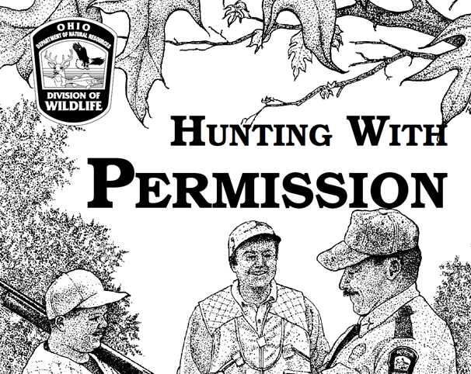
Ohio’s Cooperative Hunting, Trapping, and Fishing Program
Also known as the CHP
What is it?
How does it work?
What is in it for the landowner?
Notes:
- Ohio’s Cooperative Hunting, Trapping, and Fishing Program aims to meet this need.
Ohio’s Cooperative, Hunting, Trapping, and Fishing Program, which is also known as the CHP, is a state-run program that facilitates wildlife recreational access to private lands.
-In the CHP, landowners that are willing to grant access to wildlife recreationists can join this program and are put on a contact list.
This contact list is given to hunters by the Ohio Division of Wildlife.
Then the hunters can call the landowners to ask for permission to access their lands for hunting, trapping, or fishing.
-In return the landowners get free liability protection, free wildlife population and damage control, an increased presence of state wildlife officers, and “hunting with permission only” signs that have the Ohio Division of Wildlife’s logo on it.
-Some suggestions for the future of the program include large cash-based incentives for the landowners owning the most prime hunting land.

Slide 6

Surveys Conducted
The state governing agency was interested in revisiting the promise of the CHP in meeting its goal of connecting landowners with sportsmen and women.
Mailed-surveys were used to understand what changes need to be made to the CHP.
2018 statewide survey of CHP landowners
361 respondents
2018 statewide survey of Ohio hunters
6035 respondents
Notes:
- The state governing agency was interested in revisiting the promise of the CHP in meeting its goal of connecting landowners with sportsmen and women.
- We performed 2 surveys in 2018 for the purpose of evaluating the current CHP and determining the program preferences of CHP landowners in order to determine the need for a redesign of the program.
-Both surveys in 2018 were statewide.
-The first survey in 2018 surveyed 361 CHP landowners, and the second surveyed 6035 hunters.

Slide 7
What I Will Focus on Today
An evaluation of the outcomes of the current CHP program
The discrete choice experiment section provided to landowners
This shows what landowners would like to see in a future program
Notes:
-With these surveys we were able to gather a plethora of information about CHP landowners and hunters in Ohio.
-For example, characterizing values, motivations, and demographics of current CHP landowners around the state.
-Today I will focus on an evaluation of the outcomes of the current CHP program, and briefly discuss the discrete choice experiment section in the survey provided to CHP landowners because it shows what landowners would like to see in a future program.
-Discrete choice experiments are aimed at understanding preferences for certain program attributes (like incentives offered) compared to other attributes (like focus of the program and level of control over access).

Slide 8
Outcomes Model for Program Evaluation
Proper or Improper use of the program
Acres of land Enrolled
Program Effectiveness
Landowners
Enrolled
Physical Factors
Social Factors
Participant satisfaction
Landowner Retention Rate
New relationships between hunters and landowners
Notes:
-By looking at evaluations of similar access programs, and by mapping out the short-term, mid-term, and long-term outcomes of the program. I was able to identify 6 key outcomes for judging program effectiveness.
-One thing I noticed in the literature is that evaluation metrics used regularly noted physical attributes of other access programs but often overlooked social factors.
-I defined social factors, as the outcomes that are manifestations of the participates feelings or understanding about the program.
-Social factors include proper or improper use of the program, participant satisfaction or dissatisfaction of both hunters and landowners, and new relationships facilitated between hunters and landowners.
-Physical factors in this presentation are the outcomes that can be easily measured numerically.
-They include acres of land enrolled, landowners enrolled, and landowner retention rate.

Slide 9
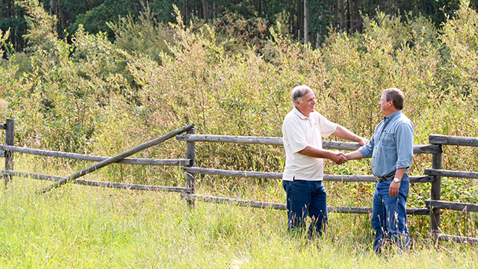
Physical Factors:
Hectares of Land Enrolled
66,927 hectares (165,380 acres) as of November 2019
Landowners Enrolled
757 landowners as of November 2019
Landowner Retention rate
Number of landowners enrolled is deceasing
Notes:
-Now for physical factors.
-As of November 2019, there are 757 landowners enrolled
-providing a total of Sixty-six thousand, nine hundred and twenty-seven hectors of land enrolled in the program.
-The exact landowner retention rate is unknown, but we do know that the number of landowners enrolled is decreasing.
- Some reasons for this happening are
private landowners selling their land for development
landowners preferring to lease their land for a fee to a single group (rather than allow free access to anyone).
Lastly some CHP landowners are too old to deal with the hassle of allowing hunters on their land.

Slide 10
Social Implication: New Relationships Facilitated Between Hunters and Landowners
2/3rds of the hunters that hunted CHP property in the 2018 survey knew the landowner before participating in the CHP.
These findings suggest that some landowners are using the program in an unintended way by taking the benefits of the program, but still only granting access to those they know.
Plans for the future program may require that landowners grant access to at least one hunter per year that they did not know previously.
Notes:
-Results from the survey of CHP landowners demonstrate that landowners were more willing to give access to friends and family than people with whom they had no acquaintance.
-We can see that landowners acted upon these preferences in the hunter survey, where we found that two thirds of the hunters who hunted CHP property knew the landowner before participating in the CHP.
-These findings suggest that some landowners are using the program in an unintended way by taking the benefits of the program, but still only granting access to those they know.
-Plans for the future program may require that landowners grant access to at least one hunter per year that they did not know previously. If this is the case, then a system will be in place to hold landowners accountable for this.

Slide 11
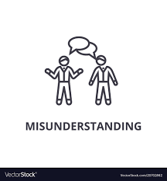
Social Implication: Participant’s Proper or Improper Usage of the Program
Most prominent causes of proper or improper usage:
Respect for and trust in the management agency
Misunderstanding how the program works
Most common misunderstanding:
Who is supposed to call who?
Having an easy-to-access, online explanation of the program and how it works could help with misunderstandings.
Notes:
-Respect for and Trust in the management agency plays a role in the participant’s usage of the program because participants are less likely to follow the rules of the program when they lack respect for and trust in the management agency that established the program.
-For example, hunters could abuse the access they are privileged with by littering on the property. Likewise, landowners could use the program in an unintended way by only giving access to those they know as we mentioned before.
-There were no questions in our survey to directly measure this, however some comments in the survey led me to believe that there are some misunderstandings in the fundamentals of the program.
-One example is hunters that left comments saying the landowner never called them. However, it was the hunter that was supposed to call the landowner.
-Having an easy-to-access, online explanation of the program and how it works could help with misunderstandings.

Slide 12
Hunter Satisfaction in Ohio
Number of deer on property hunted most
Number of antlered deer on property hunted most
Number of deer harvested
Hunting pressure
Management of Ohio's deer herd
Overall deer hunting experience
Fig 1A. Satisfaction on CHP lands.
Fig 1B. Satisfaction on public lands.
Notes:
- Our CHP landowner survey did not measure participant satisfaction, but our hunter survey did, and our findings were intriguing.
-In these graphs, deer hunt satisfaction for various aspects of the deer hunt was deer hunters on CHP land (in Figure 1A on the right), and deer hunters on public land (In Figure 1B).
-The percentage of hunters that were dissatisfied or somewhat dissatisfied is shown in red and the percentage of hunters that were satisfied or somewhat satisfied is shown in white.
-Measures of satisfaction or dissatisfaction include:
number of deer on the land hunted most,
number of antlered deer on the land hunted most,
number of deer harvested,
hunting pressure,
management of Ohio’s deer herd,
and overall hunting experience.
- From a glance at the lack of white and abundance of red in figure 1B, you can see the most dissatisfaction lies with the deer hunting experience on public land.
- In Figure 1A, Hunters appear to be satisfied, which is an important metric related to half of the hunter-landowner relationship, and likely indicates further demand for such lands to be enrolled exist.

Slide 13
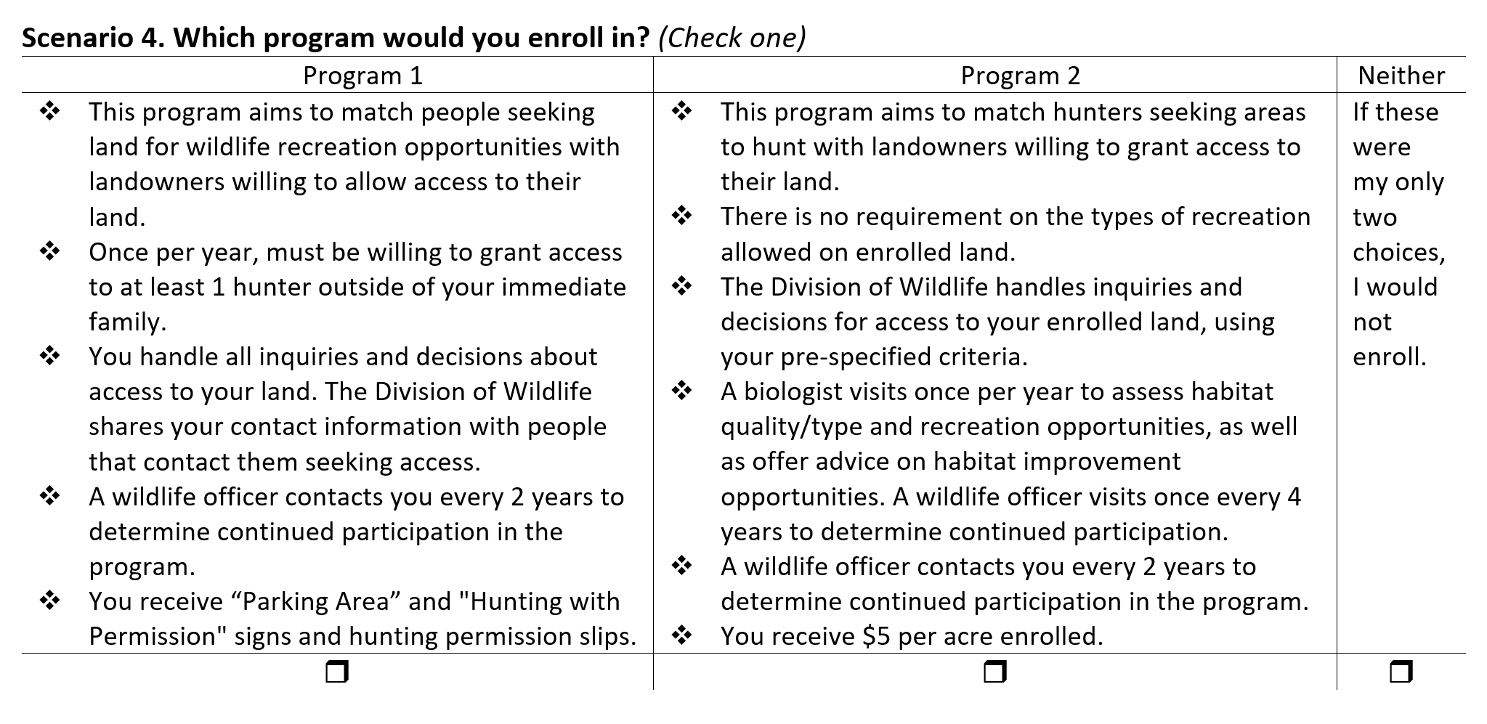
Discrete Choice Experiment Section
Factors of the program that were assessed for preferences:
Focus of the program
Recreation requirement
Frequency of contact
Control over access
Incentives offered
Individuals are assumed to choose the scenario that maximizes their satisfaction (Louviere et al. 2008).
Notes:
-A discrete choice experiment was used in the landowner surveys to determine preferences for an ideal program.
-Choice experiments included 8 hypothetical scenarios, in which respondents decided between 2 possible programs or a “neither choice option”. Each scenario varied on a set number of factors including
focus of the program
Recreation requirement
frequency of contact
control over access
and incentives offered.
-Each factor has several different levels of statements with a different combination of statements in each program scenario.
-Individuals are assumed to choose the scenario that maximizes their satisfaction (Louviere et al. 2008).

Slide 14
Discrete Choice Experiment Section
Key Findings:
CHP landowners don’t want small payments of $2-$5 per acre
CHP landowners want to make the decisions over who gets access
CHP Landowners want to have law enforcement around more frequently.
Notes:
-We found that regarding incentives, landowners preferred signage with the agency logo and permission slips over direct payments, such as $2-5 per acre
-Also, CHP landowners want to personally make the decisions over who gets access as opposed to letting Ohio Division of Wildlife handle decisions and inquires about access to the land, using the landowners pre-specified criteria.
- Lastly, landowners want to have law enforcement around more frequently. This is likely because most of the CHP landowners are old and likewise have trouble protecting all their land from trespassers, so the idea of wildlife officers coming to check on their land means a lot to them.

Slide 15
Relative Importance of Factors on Enrollment Choice
Notes:
-Here is a chart showing how important each factor of the program was to CHP landowners in the discrete choice section of the survey.
-The factors with the biggest portion of the chart are the factors that were most often the deciding issue for landowners in which program to choose.
-Control over access was the biggest contributing factor when choosing a program. Ohio landowners care about maintaining complete control over access to their lands.
- Second in relative importance was incentives which is surprising because it was rather important to landowners to not get small money incentives of $2 per acre.
-The reason we think landowners instead care more about signage is that signs have a state government logo on them, giving the impression to potential trespassers that this land is watched by the government.
-Lastly, the focus of the program, whether the purpose of the program was for hunting only or for general wildlife recreational activity, mattered relatively little to the landowners.

Slide 16
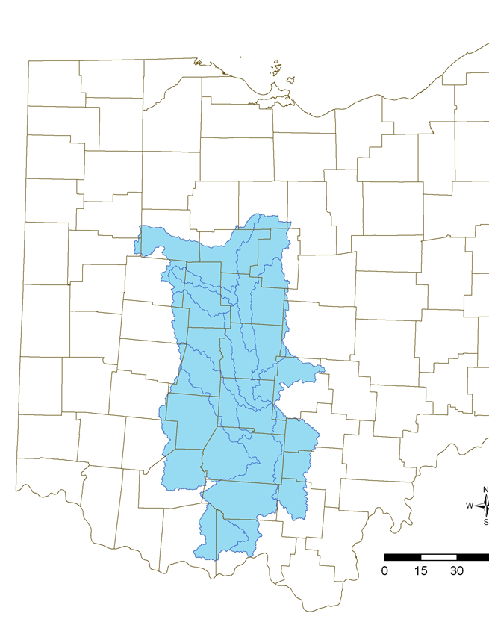
Future Work
2019 survey of landowners owning 10 acres:
Focused on the Scioto River watershed due to limited hunting lands in proportion to hunters.
1512 respondents
2019 pilot survey of Scioto CREP landowners:
The CREP (Conservation Reserve Enhancement Program) is suspected to lose land due to reduced payments to landowners. We focused on these landowners, offering larger payments in the survey’s choice experiment section, to keep their lands in the CREP.
298 respondents
Still working on analysis of the 2019 surveys
Notes:
- We ran 2 surveys in 2019 that gathered the opinions of Ohio landowners owning lands that Ohio Division of Wildlife are most interested in recruiting into the program.
- In these surveys we focused on counties that have land in the Scioto River Watershed because of the limited hunting lands in this area in proportion to hunters. On the right, in the map of Ohio, you can see the Scioto River Watershed in blue, and the black boundaries are counties.
- The first survey in 2019 surveyed 1,512 private landowners in or near the Scioto River Watershed.
- The second survey in 2019 surveyed 298 landowners in The Scioto River Watershed that were also enrolled in the federal Conservation Reserve Enhancement Program.
- We finished collecting completed surveys in January and are currently working on the analysis of these surveys.

Slide 17
Conclusion
The Cooperative, Hunting, Trapping, and Fishing Program intends to provides a private land hunting experience to all Ohio hunters.
Mapping out the physical and social factors of a program, such as the CHP, can help identify the strengths and weaknesses of the program.
Surveys from 2018 and 2019 will help us design a better access program in the future.
Notes:
-In conclusion, the Cooperative, Hunting, Trapping, and Fishing Program intends to provide a private land hunting experience to all Ohio hunters. Although, results of the 2018 surveys suggest that not all private landowners are reaching new hunters. They are however, providing important opportunities to hunters for which relationships are established, and doing a good job of meeting the interests of some deer hunters, as evidenced by their high satisfaction levels regarding deer hunts on CHP lands compared to public lands.
-Mapping out the physical and social factors of a program, such as the CHP, can help identify the strengths and weaknesses of the program which is what ultimately contributes to the program’s success.
-These results, combined with additional analyses we are conducting, will help to assess the need for further redesign of the program connecting landowners and hunters.

Slide 18
Thank you

